Slide 1
Artificial Intelligence
Dr. O. I. Adelaiye

Slide 2
Expert System
Lecture 6

Slide 3
Introduction
An expert, more generally, is a person with
Extensive knowledge or ability based on research,
Experience, or
Occupation and in a particular area of study.

Slide 4
Introduction
Experts are called in for advice on their respective subject,
But they do not always agree on the particulars of a field of study.
Having, involving, or displaying special skill or knowledge derived from training or experience

Slide 5
Introduction
An medical Doctor will be the wrongest person to ask the ratio of cement to sand in the construction of blocks.
In Nigeria we see Lawyer with all there learnedness can not write a program to calculate ordinary square root.
It requires experts in the field.

Slide 6
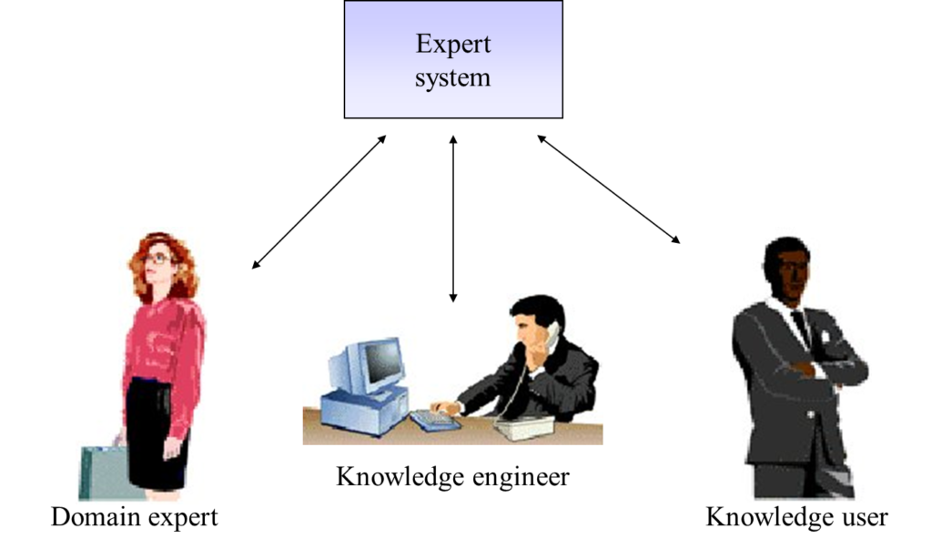
Introduction

Slide 7
Expert System
Designed to solve real problems in a particular domain that normally would require a human expert.
It can solve many types of problems
Developing an expert system involves extracting relevant knowledge from human experts in the area of problem, called domain experts.

Slide 8
Expert System
Computer programs that try to replicate knowledge and skills of human experts in some area, and then solve problems in this area (the way human experts would)
Take their roots in Cognitive Science: the study of human mind using combination of AI and psychology

Slide 9
Expert System
First successful applications of AI to real-world problems, solving problems in medicine, chemistry, finance and even in space (Space Shuttle, robots on other planets)
In business, Expert System allows many companies to save millions of dollars

Slide 10
What are Expert Systems in Summary?
The expert systems are the computer applications developed to solve complex problems in a particular domain, at the level of extra-ordinary human intelligence and expertise.

Slide 11
Characteristics of Expert Systems
High performance
Understandable
Reliable
Highly responsive

Slide 12
Capabilities of Expert Systems
The expert systems are capable of −
Advising
Instructing and assisting human in decision making
Demonstrating
Deriving a solution
Diagnosing
Explaining
Interpreting input
Predicting results
Justifying the conclusion
Suggesting alternative options to a problem

Slide 13
Capabilities of Expert Systems
They are incapable of −
Substituting human decision makers
Possessing human capabilities
Producing accurate output for inadequate knowledge base
Refining their own knowledge

Slide 14
Components of Expert Systems
Knowledge Base
Inference Engine
User Interface

Slide 15
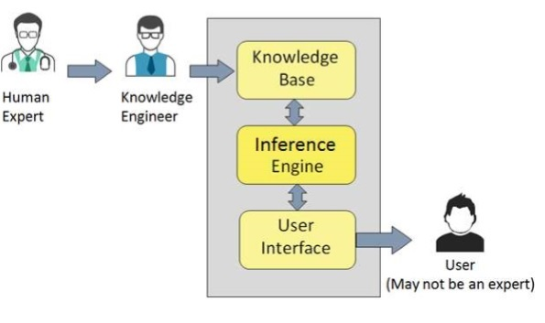

Slide 16
Knowledge Base
It contains domain-specific and high quality knowledge.
Knowledge is required to exhibit intelligence. The success of any ES majorly depends upon the collection of highly accurate and precise knowledge.

Slide 17
What is Knowledge?
Data is collection of facts.
Information is organized as data and facts about the task domain.
Data, information, and past experience combined together are termed as knowledge.

Slide 18
Components of Knowledge Base
The knowledge base of an ES is a store of both, factual and heuristic knowledge.
Factual Knowledge − It is the information widely accepted by the Knowledge Engineers and scholars in the task domain.
Heuristic Knowledge − It is about practice, accurate judgment, one’s ability of evaluation, and guessing.

Slide 19
Knowledge Representation
It is the method used to organize and formalize the knowledge in the knowledge base.
It is in the form of IF-THEN-ELSE rules.

Slide 20
Knowledge Acquisition
The success of any expert system majorly depends on the quality, completeness, and accuracy of the information stored in the knowledge base.
The knowledge base is formed by readings from various experts, scholars, and the Knowledge Engineers. The knowledge engineer is a person with the qualities of empathy, quick learning, and case analyzing skills.

Slide 21
Knowledge Acquisition
He acquires information from subject expert by recording, interviewing, and observing him at work, etc.
He then categorizes and organizes the information in a meaningful way, in the form of IF-THEN-ELSE rules, to be used by interference machine.
The knowledge engineer also monitors the development of the ES.

Slide 22
Inference Engine
Use of efficient procedures and rules by the Inference Engine is essential in deducting a correct, flawless solution.
In case of knowledge-based ES, the Inference Engine acquires and manipulates the knowledge from the knowledge base to arrive at a particular solution.

Slide 23
Inference Engine
In case of rule based ES, it −
Applies rules repeatedly to the facts, which are obtained from earlier rule application.
Adds new knowledge into the knowledge base if required.
Resolves rules conflict when multiple rules are applicable to a particular case.

Slide 24
Inference Engine
To recommend a solution, the Inference Engine uses the following strategies −
Forward Chaining
Backward Chaining

Slide 25
Forward Chaining
It is a strategy of an expert system to answer the question, “What can happen next?”
Here, the Inference Engine follows the chain of conditions and derivations and finally deduces the outcome. It considers all the facts and rules, and sorts them before concluding to a solution.
This strategy is followed for working on conclusion, result, or effect. For example, prediction of share market status as an effect of changes in interest rates.

Slide 26
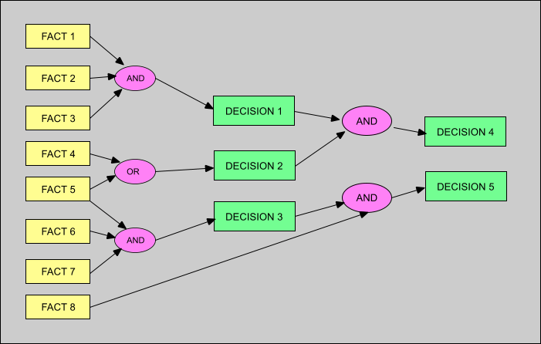

Slide 27
Backward Chaining
With this strategy, an expert system finds out the answer to the question, “Why this happened?”
On the basis of what has already happened, the Inference Engine tries to find out which conditions could have happened in the past for this result.
This strategy is followed for finding out cause or reason. For example, diagnosis of blood cancer in humans.

Slide 28
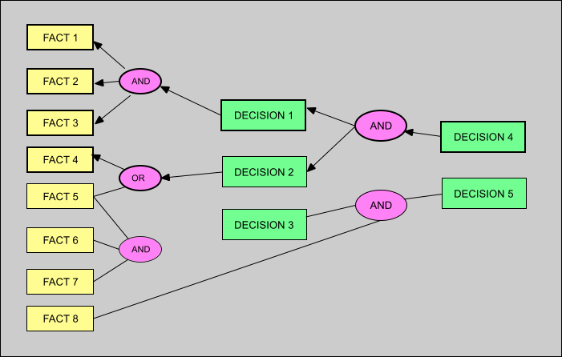

Slide 29
User Interface
User interface provides interaction between user of the ES and the ES itself.
Generally Natural Language Processing so as to be used by the user who is well-versed in the task domain.
The user of the ES need not be necessarily an expert in Artificial Intelligence.

Slide 30
User Interface
It explains how the ES has arrived at a particular recommendation. The explanation may appear in the following forms:
Natural language displayed on screen.
Verbal narrations in natural language.
Listing of rule numbers displayed on the screen.
The user interface makes it easy to trace the credibility of the deductions.

Slide 31
Requirements of Efficient ES User Interface
It should help users to accomplish their goals in shortest possible way.
It should be designed to work for user’s existing or desired work practices.
Its technology should be adaptable to user’s requirements; not the other way round.
It should make efficient use of user input.

Slide 32
Expert Systems Limitations
No technology can offer easy and complete solution. Large systems are costly, require significant development time, and computer resources. ESs have their limitations which include:
Limitations of the technology
Difficult knowledge acquisition
ES are difficult to maintain
High development costs

Slide 33
Applications of Expert System
Application | Description
Design Domain | Camera lens design, automobile design.
Medical Domain | Diagnosis Systems to deduce cause of disease from observed data, conduction medical operations on humans.
Monitoring Systems | Comparing data continuously with observed system or with prescribed behavior such as leakage monitoring in long petroleum pipeline.
Process Control Systems | Controlling a physical process based on monitoring.
Knowledge Domain | Finding out faults in vehicles, computers.
Finance/Commerce | Detection of possible fraud, suspicious transactions, stock market trading, Airline scheduling, cargo scheduling.

Slide 34
Development of Expert Systems: General Steps
The process of ES development is iterative. Steps in developing the ES include −
Identify Problem Domain
The problem must be suitable for an expert system to solve it.
Find the experts in task domain for the ES project.
Establish cost-effectiveness of the system.

Slide 35
Development of Expert Systems: General Steps
Design the System
Identify the ES Technology
Know and establish the degree of integration with the other systems and databases.
Realize how the concepts can represent the domain knowledge best.

Slide 36
Development of Expert Systems: General Steps
Develop the Prototype
From Knowledge Base: The knowledge engineer works to −
Acquire domain knowledge from the expert.
Represent it in the form of If-THEN-ELSE rules.

Slide 37
Development of Expert Systems: General Steps
Test and Refine the Prototype
The knowledge engineer uses sample cases to test the prototype for any deficiencies in performance.
End users test the prototypes of the ES.

Slide 38
Development of Expert Systems: General Steps
Develop and Complete the ES
Test and ensure the interaction of the ES with all elements of its environment, including end users, databases, and other information systems.
Document the ES project well.
Train the user to use ES.

Slide 39
Development of Expert Systems: General Steps
Maintain the System
Keep the knowledge base up-to-date by regular review and update.
Cater for new interfaces with other information systems, as those systems evolve.

Slide 40
Benefits of Expert System
Availability: They are easily available due to mass production of software.
Less Production Cost: Production cost is reasonable. This makes them affordable.
Speed: They offer great speed. They reduce the amount of work an individual puts in.

Slide 41
Benefits of Expert System
Less Error Rate: Error rate is low as compared to human errors.
Reducing Risk: They can work in the environment dangerous to humans.
Steady response: They work steadily without getting motional, tensed or fatigued.

Slide 42


